Slide 1
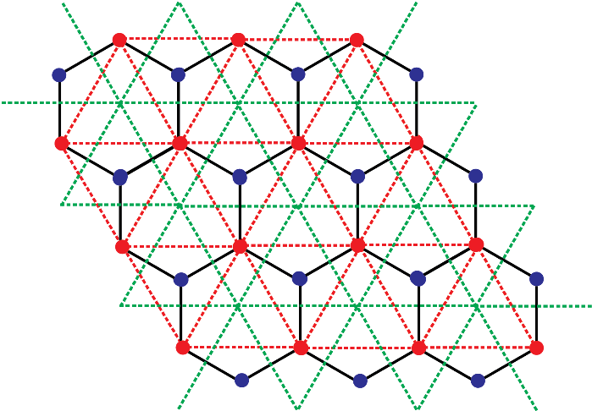
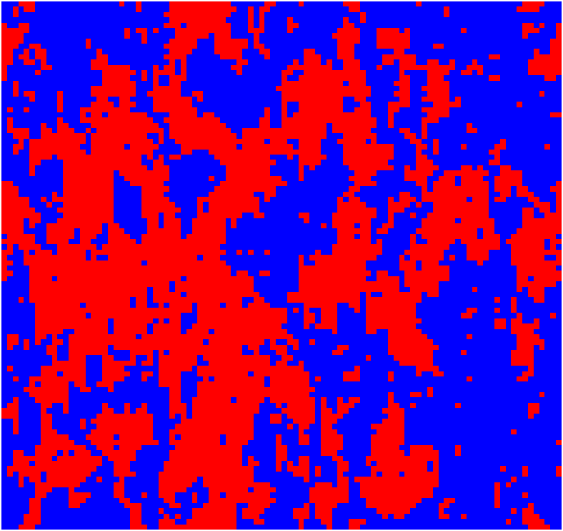
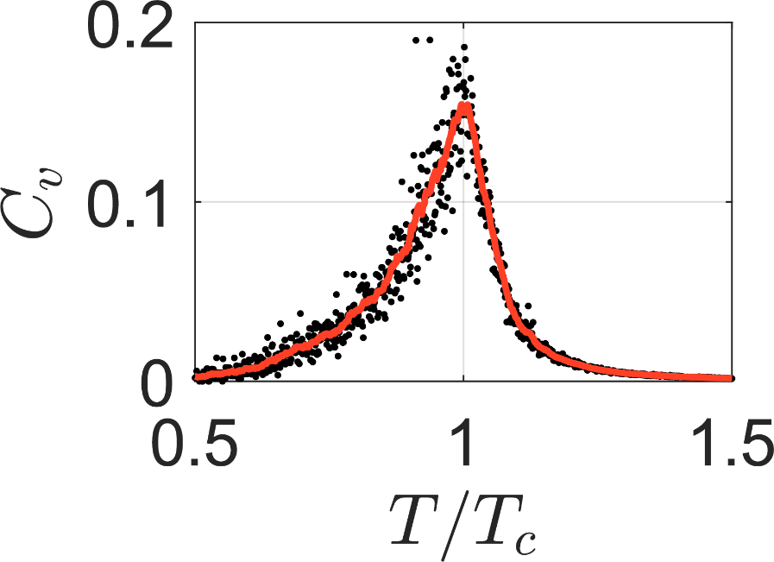
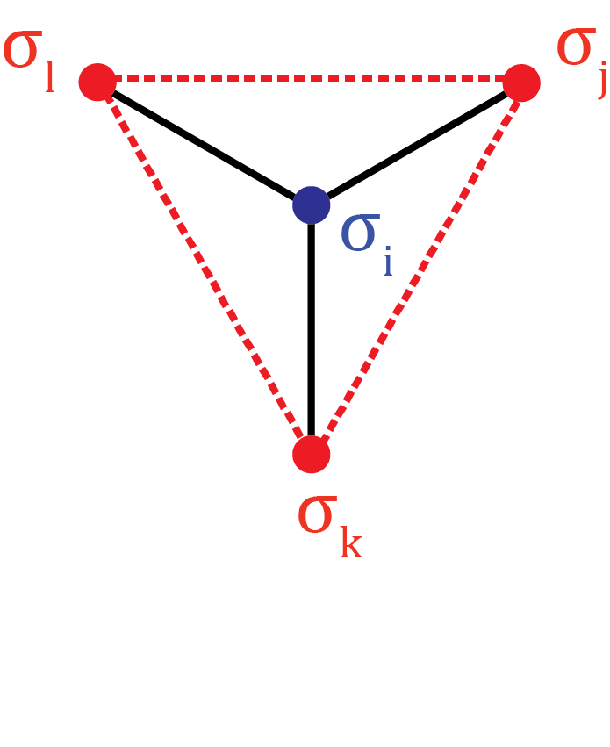
Critical Point of a 2D Ising Honeycomb Lattice
Rishav Koirala, Haotian Song
Project Presentation PC5202 Advanced Statistical Mechanics

Slide 2
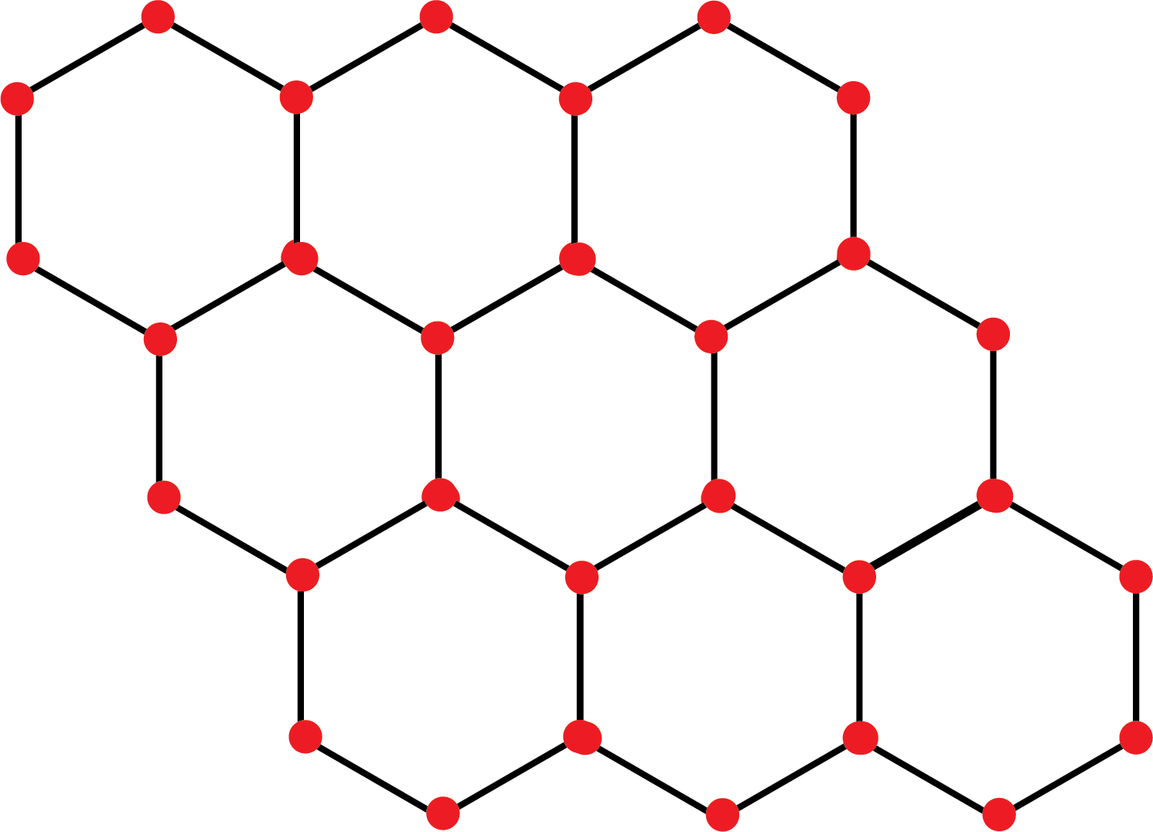
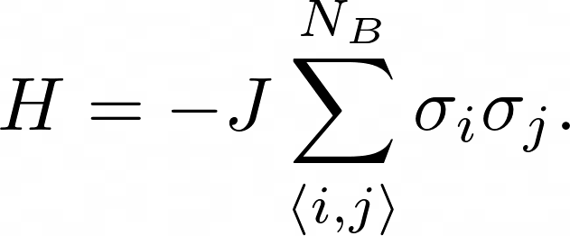
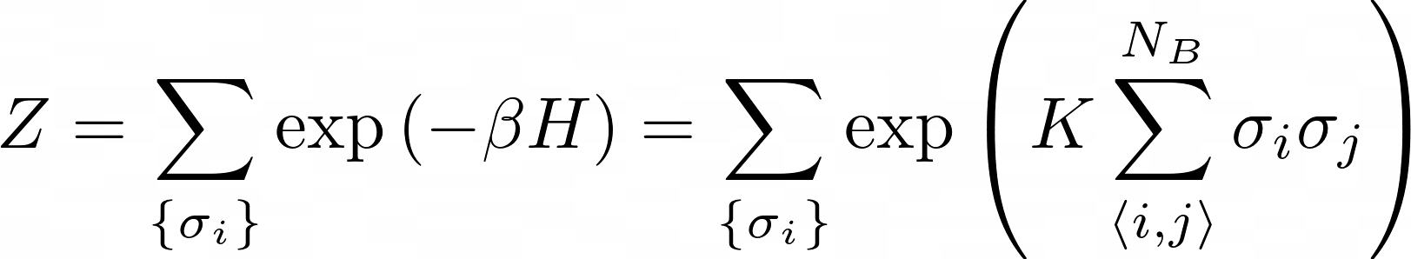
Introduction

Slide 3
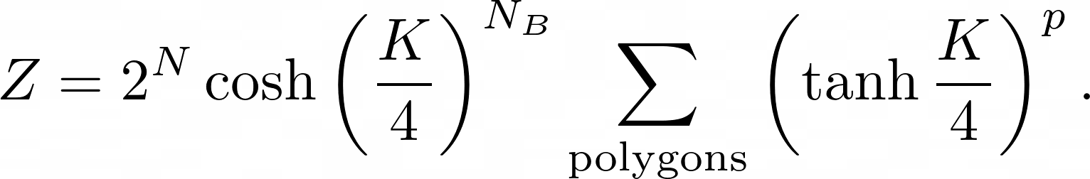
Partition Function – High Temperature Model

Slide 4
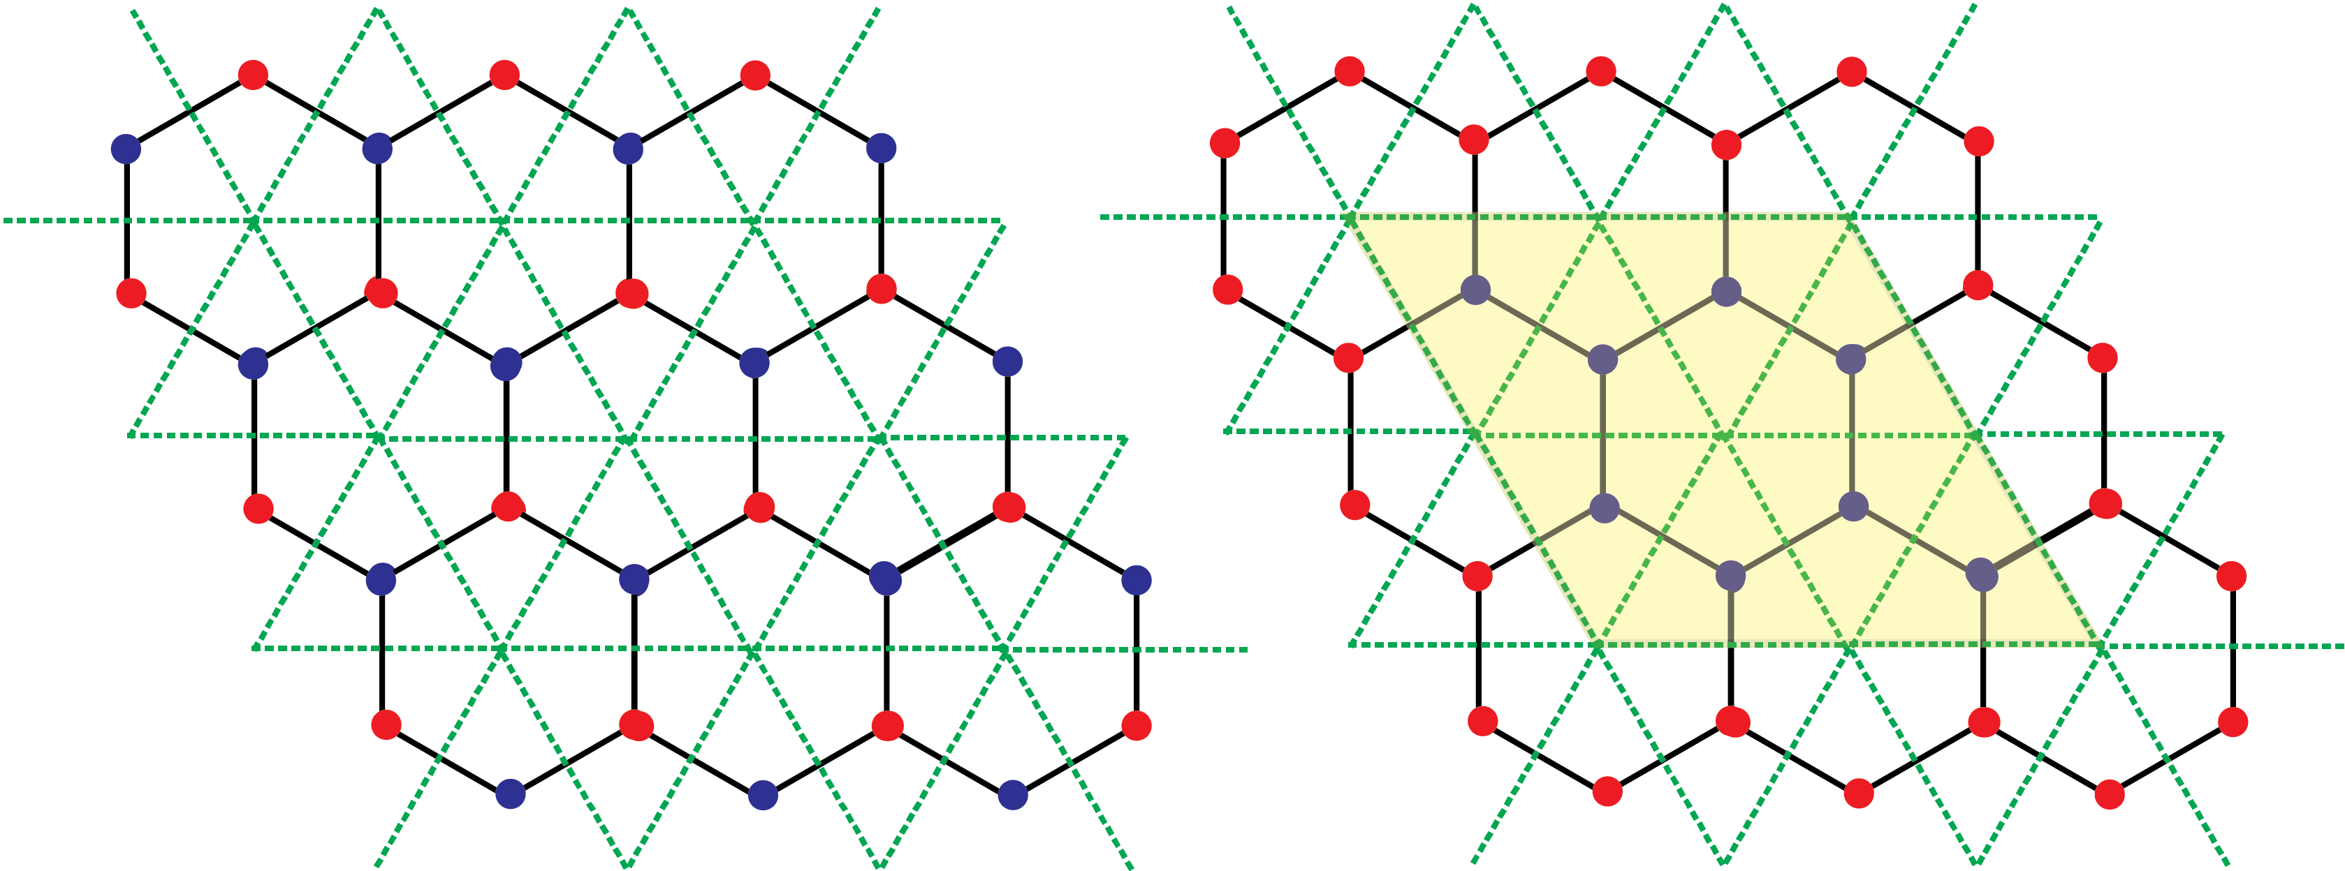
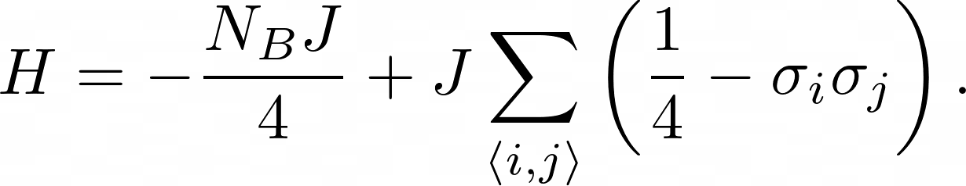
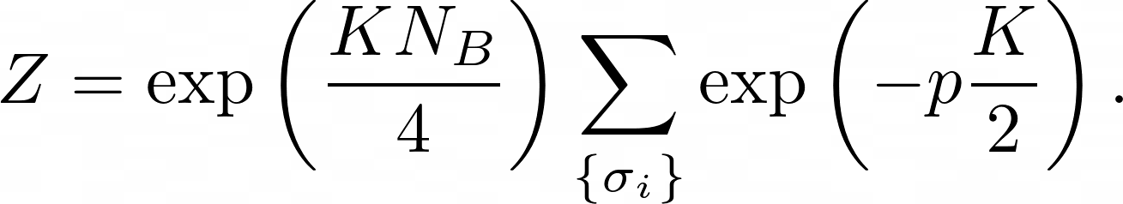
Partition Function – Low Temperature Model

Slide 5
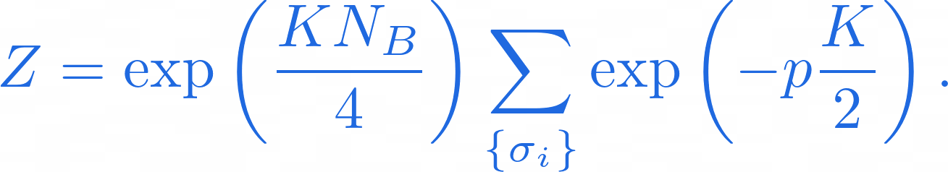
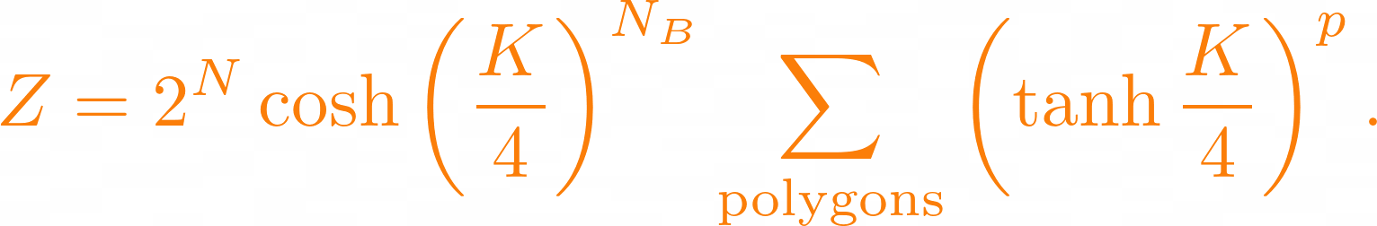
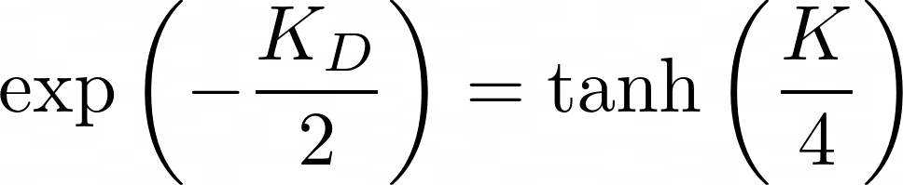
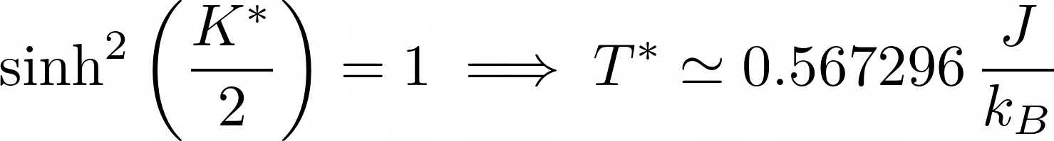
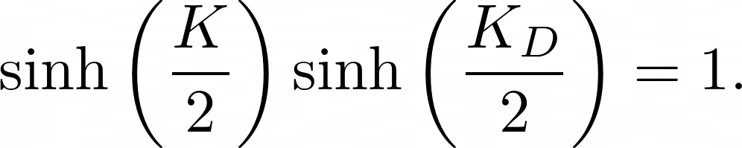
Duality Relation

Slide 6
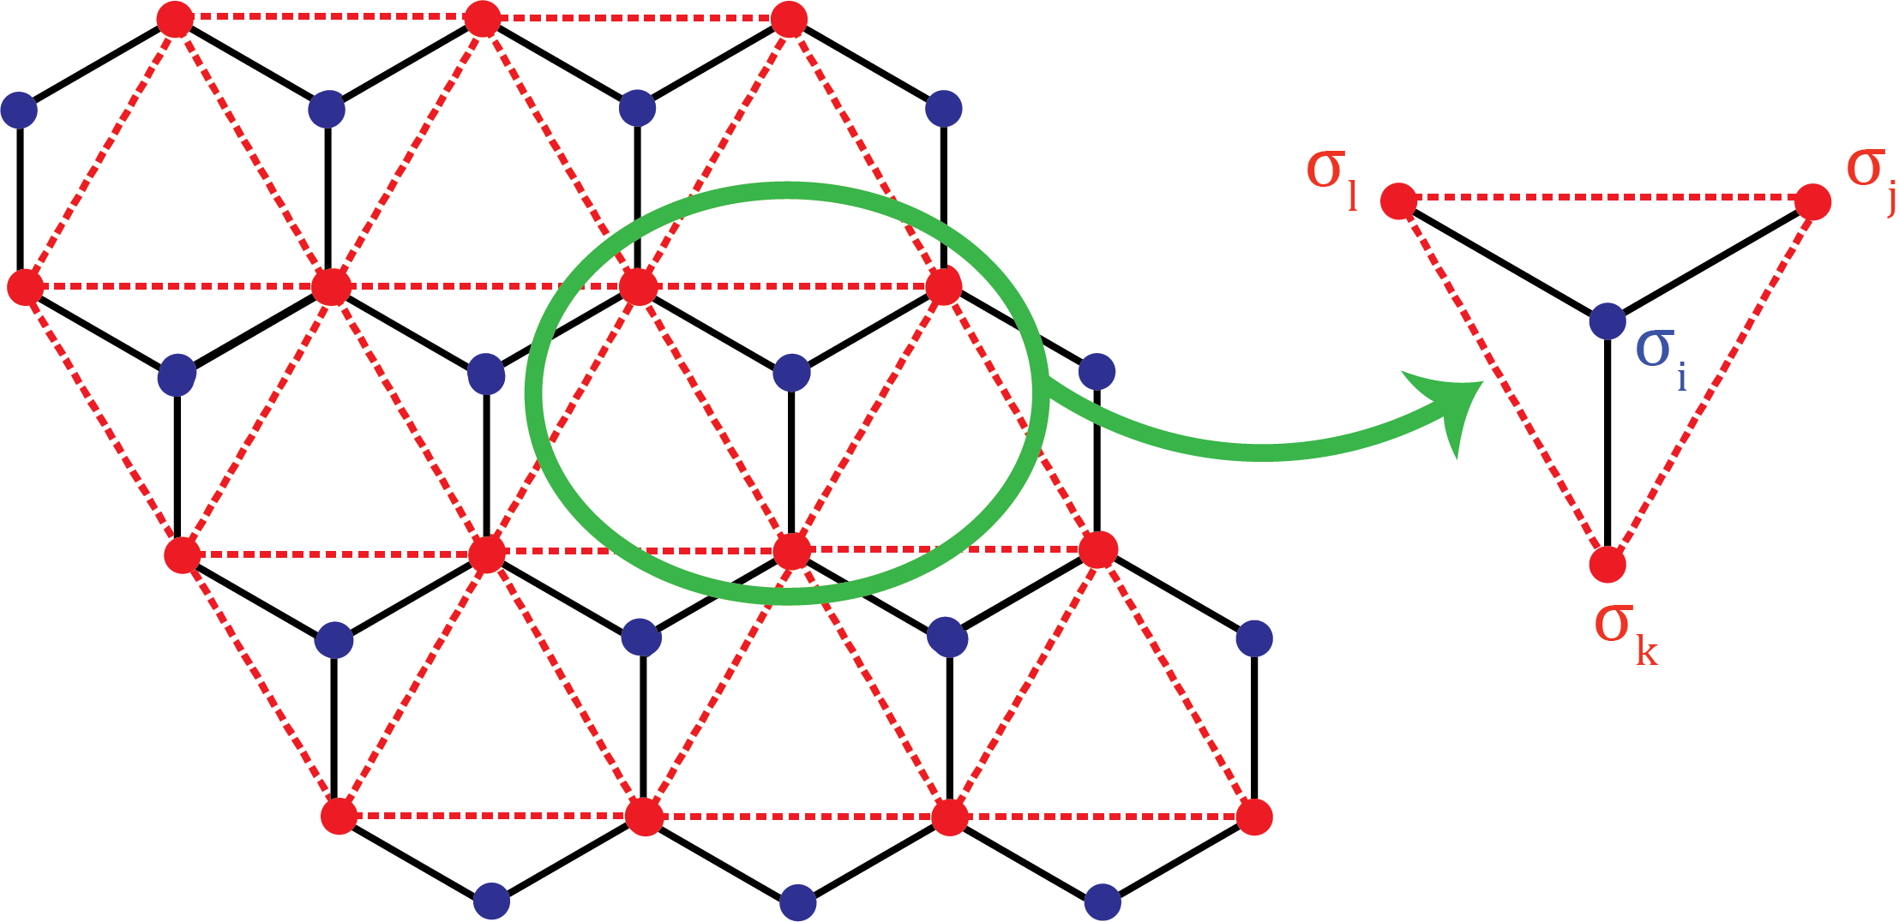
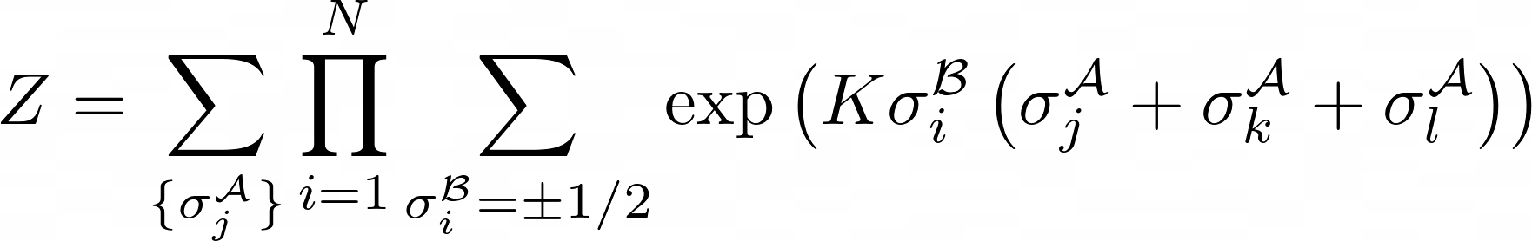
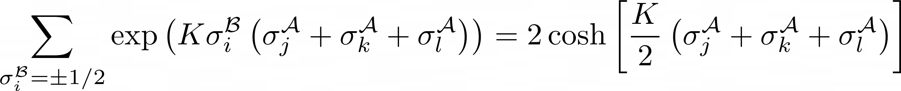
Star-Triangle Transformation I

Slide 7
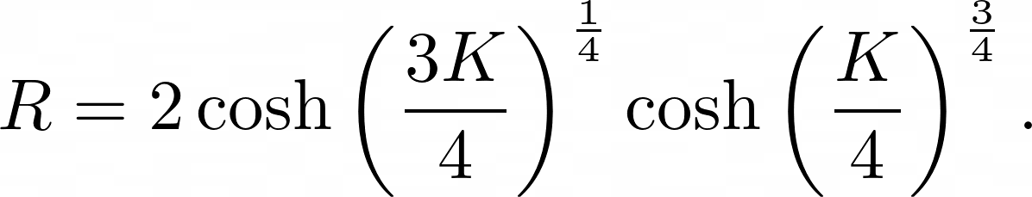
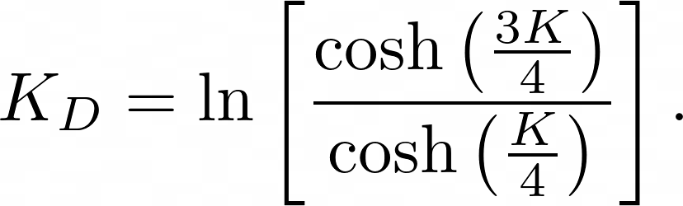
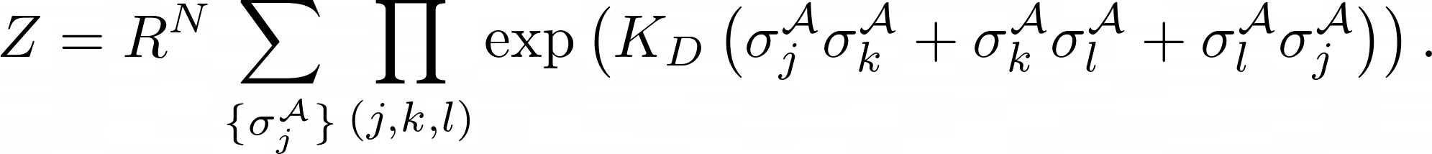
Star-Triangle Transformation II

Slide 8
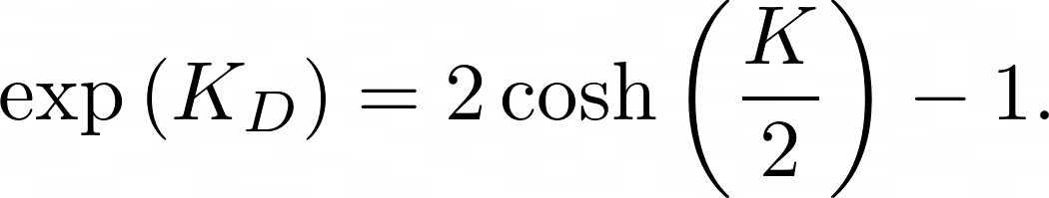
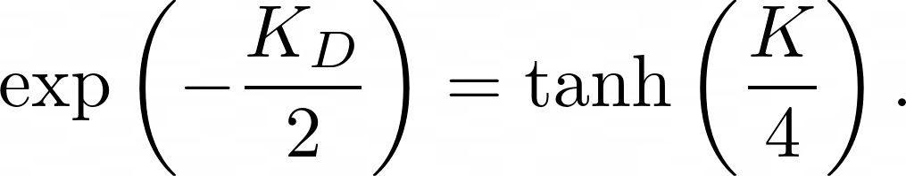
Star-Triangle Transformation III

Slide 9
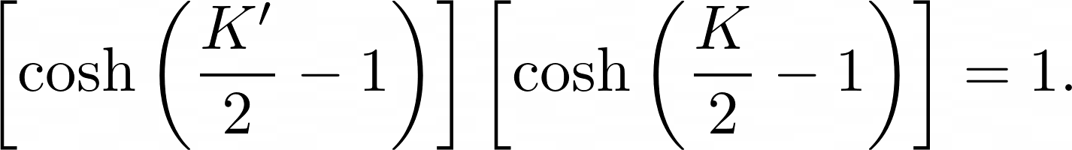
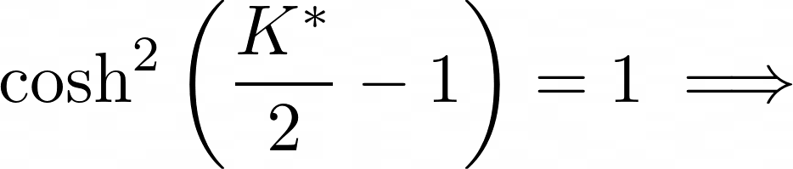
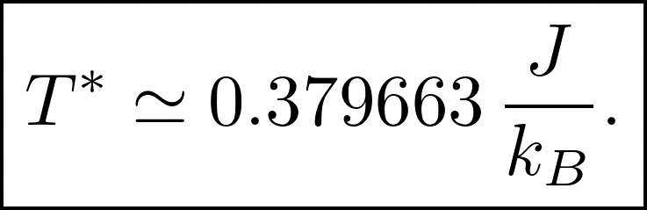
The Critical Point

Slide 10
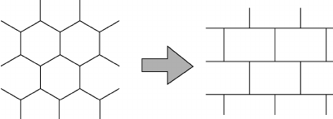
The transformation to a brick lattice
(1,1)
(1,3)
(1,5)
(1,1)
(1,3)
(1,5)
(1,2)
(1,4)
(1,2)
(1,4)
(2,2)
(2,4)
(2,2)
(2,4)
(2,1)
(2,3)
(2,5)
(2,1)
(2,3)
(2,5)
(3,1)
(3,3)
(3,5)
(3,1)
(3,3)
(3,5)
(3,2)
(3,4)
(3,2)
(3,4)
Wakabayashi, Katsunori, Mitsutaka Fujita, Hiroshi Ajiki, and Manfred Sigrist (Mar. 1999). “Electronic and magnetic properties of nanographite ribbons”. In: Phys. Rev. B 59 (12), pp. 8271–8282.

Slide 11
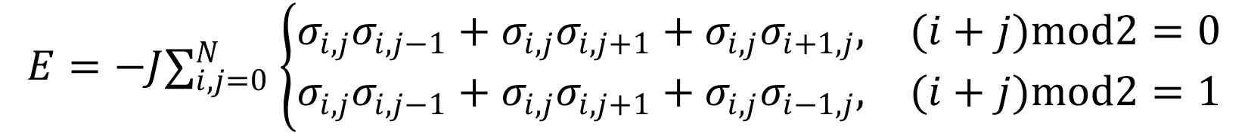
The transformation to a brick lattice
Bottom
Top
Right
$$E=−J∑_{i,j=0}^{N} \left\{\begin{matrix}σ_{i,j}σ_{i,j−1}+σ_{i,j}σ_{i,j+1}+σ_{i,j}σ_{i+1,j}, & (i+j)mod2=0 \\ σ_{i,j}σ_{i,j−1}+σ_{i,j}σ_{i,j+1}+σ_{i,j}σ_{i−1,j}, & (i+j)mod2=1\end{matrix}\right.$$
Bottom
Top
Left
Wakabayashi, Katsunori, Mitsutaka Fujita, Hiroshi Ajiki, and Manfred Sigrist (Mar. 1999). “Electronic and magnetic properties of nanographite ribbons”. In: Phys. Rev. B 59 (12), pp. 8271–8282.

Slide 12
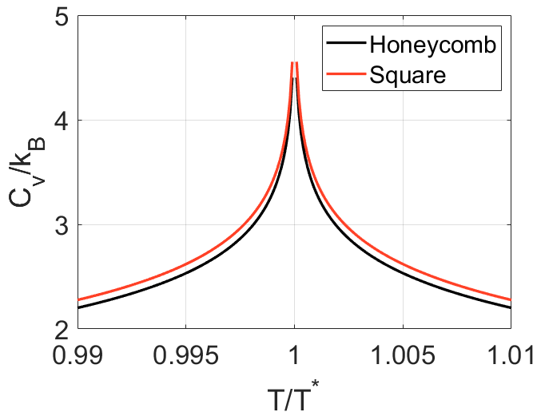
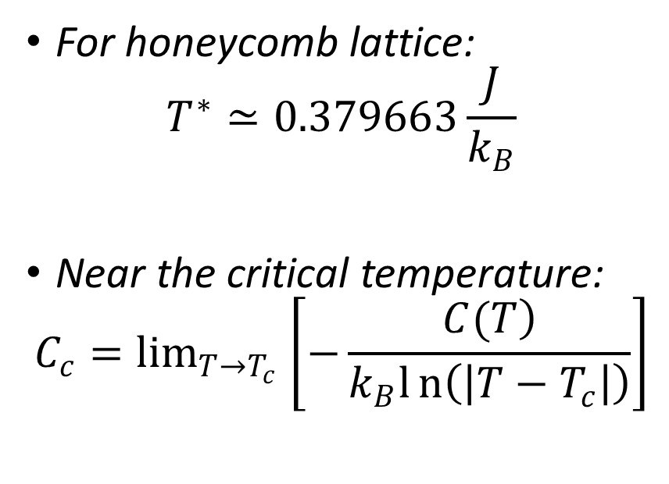
Numerical solution
For honeycomb lattice:
$$T^{∗}≃0.379663\frac{J}{k_{B}}$$
Near the critical temperature:
$$C_{c}=\lim_{T→T_{c}} \left[−\frac{\left.C(T\right)}{k_{B}ln\left(\left|T−T_{c}\right|\right)}\right]$$
Houtappel, Raymond Marie Ferdinand (1950). “Order-disorder in hexagonal lattices”. In Physica 16.5, pp. 425–455.

Slide 13
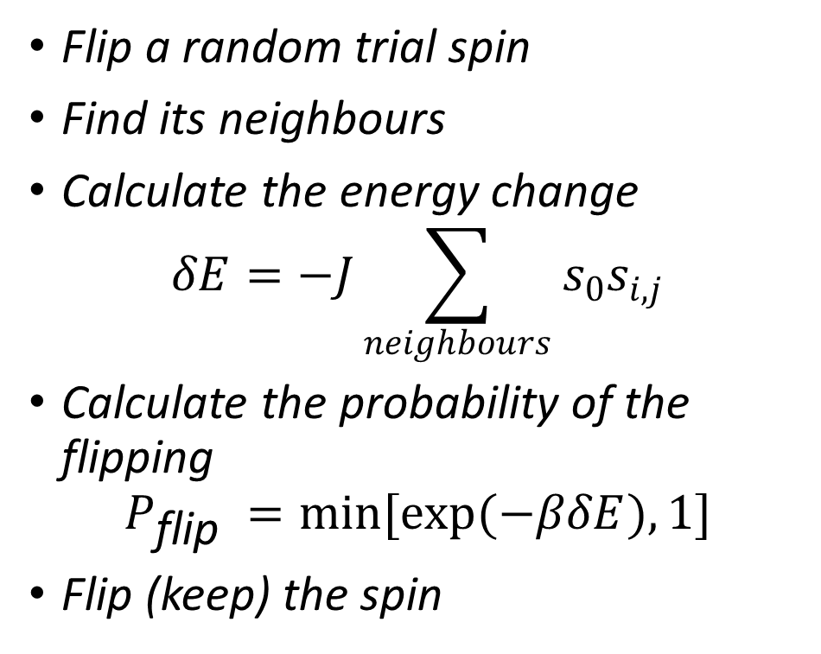
The Monte Carlo Method
Flip a random trial spin
Find its neighbours
Calculate the energy change
$$δE=−J\sum_{neighbours}{s_{0}s_{i,j}}$$
Calculate the probability of the flipping
$$P_{\text{flip} }=min[exp(−βδE),1]$$
Flip (keep) the spin
The simulation codes are available at https://github.com/wonderingmark123/Ising-Model-Honeycomb

Slide 14
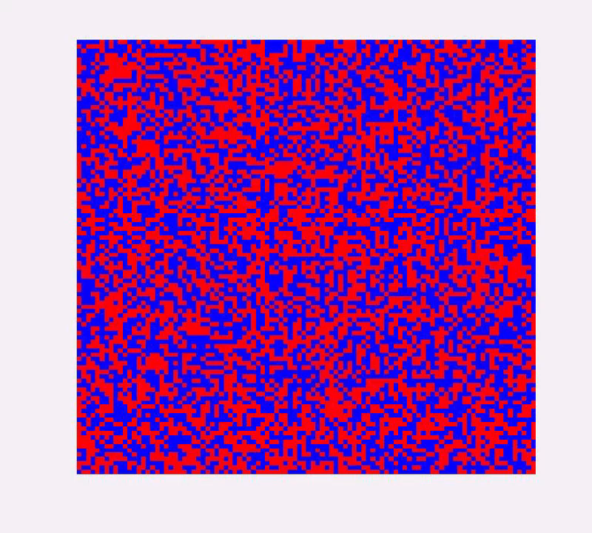
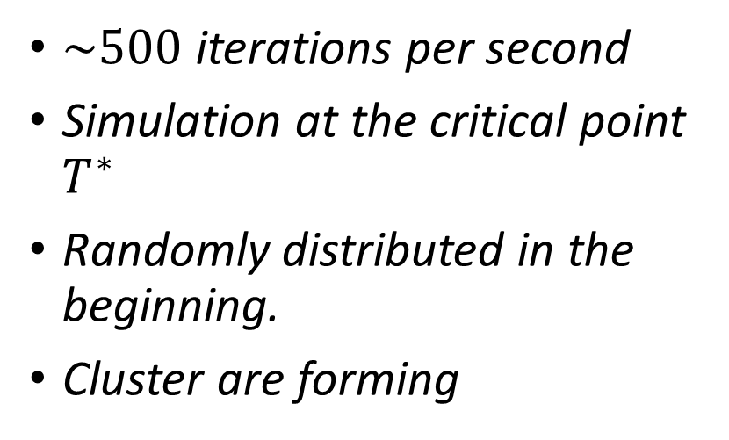
The Monte Carlo Method
$\sim 500$ iterations per second
Simulation at the critical point $T^{∗}$
Randomly distributed in the beginning.
Cluster are forming

Slide 15
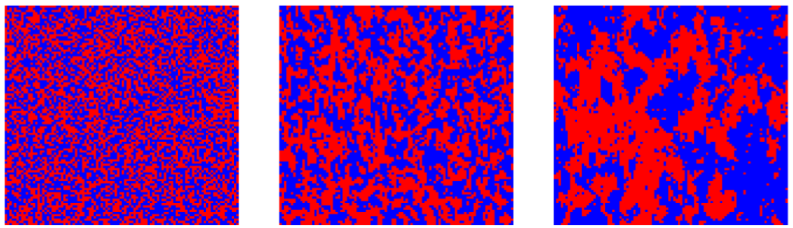


The Monte Carlo Method
0 iteration
Initial condition
$3×{10}^{4}$ iteration
$6×{10}^{5}$ iteration

Slide 16
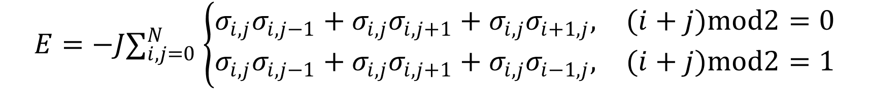
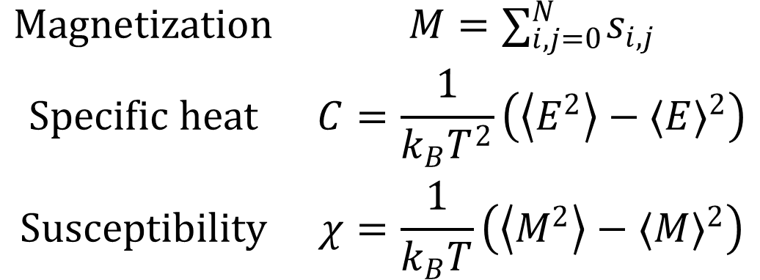
Thermodynamics properties
$$E=−J∑_{i,j=0}^{N} \left\{\begin{matrix}σ_{i,j}σ_{i,j−1}+σ_{i,j}σ_{i,j+1}+σ_{i,j}σ_{i+1,j}, & (i+j)mod2=0 \\ σ_{i,j}σ_{i,j−1}+σ_{i,j}σ_{i,j+1}+σ_{i,j}σ_{i−1,j}, & (i+j)mod2=1\end{matrix}\right.$$
$$\begin{matrix}Magnetization & M=∑_{i,j=0}^{N} s_{i,j} \\ Specific heat & C=\frac{1}{k_{B}T^{2}}\left(\left\langle E^{2}\right\rangle −⟨E⟩^{2}\right) \\ Susceptibility & χ=\frac{1}{k_{B}T}\left(\left\langle M^{2}\right\rangle −⟨M⟩^{2}\right)\end{matrix}$$

Slide 17
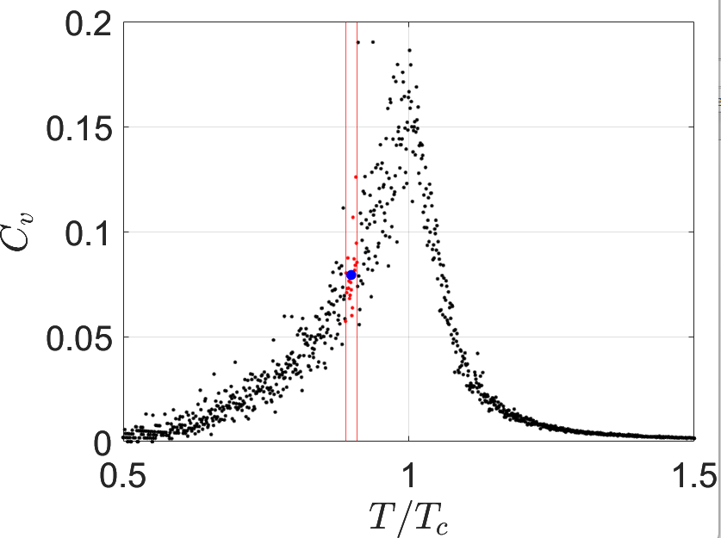
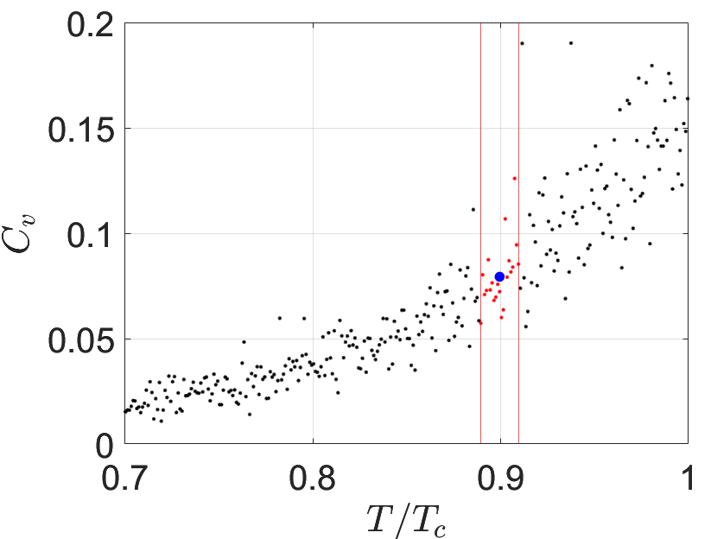
Derive the statistical average

Slide 18
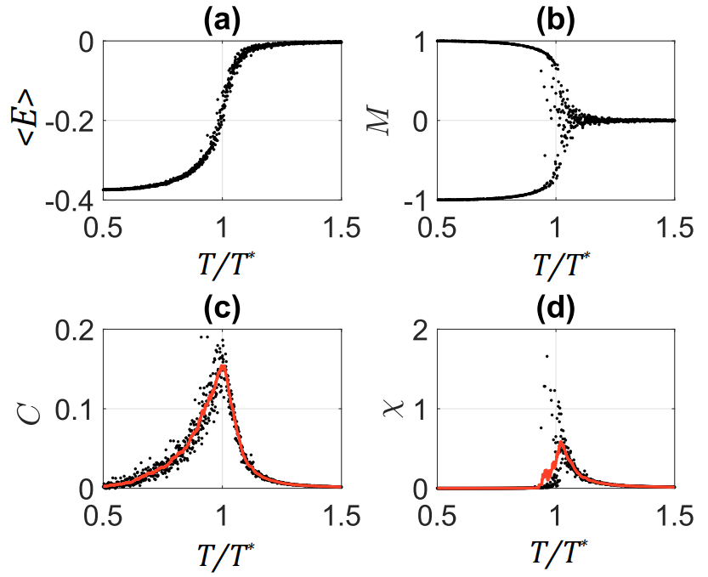
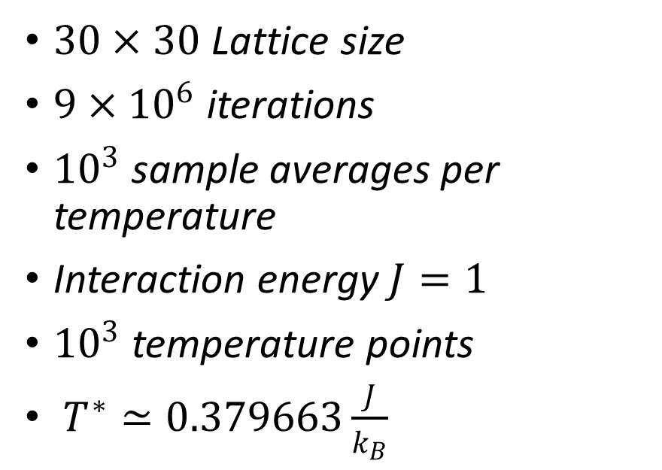
Simulation for honeycomb lattice
$30×30$ Lattice size
$9×{10}^{6}$ iterations
${10}^{3}$ sample averages per temperature
Interaction energy $J=1$
${10}^{3}$ temperature points
$T^{∗}≃0.379663\frac{J}{k_{B}}$

Slide 19
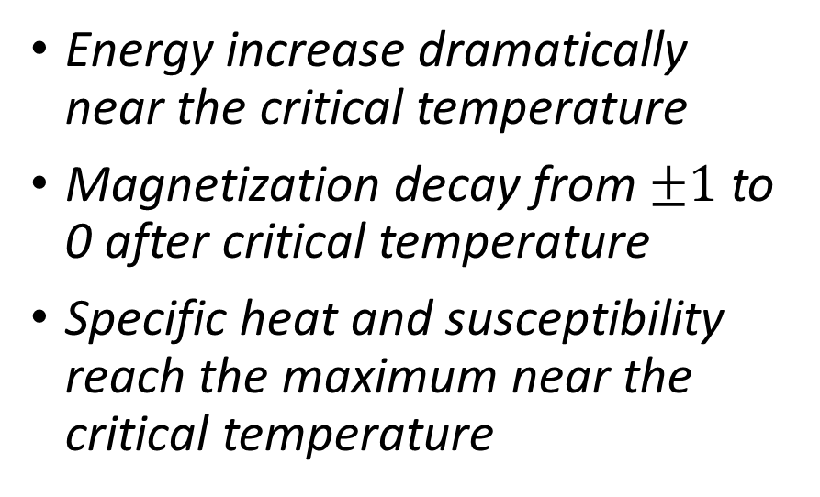
Simulation for honeycomb lattice
Energy increase dramatically near the critical temperature
Magnetization decay from $±1$ to 0 after critical temperature
Specific heat and susceptibility reach the maximum near the critical temperature

Slide 20
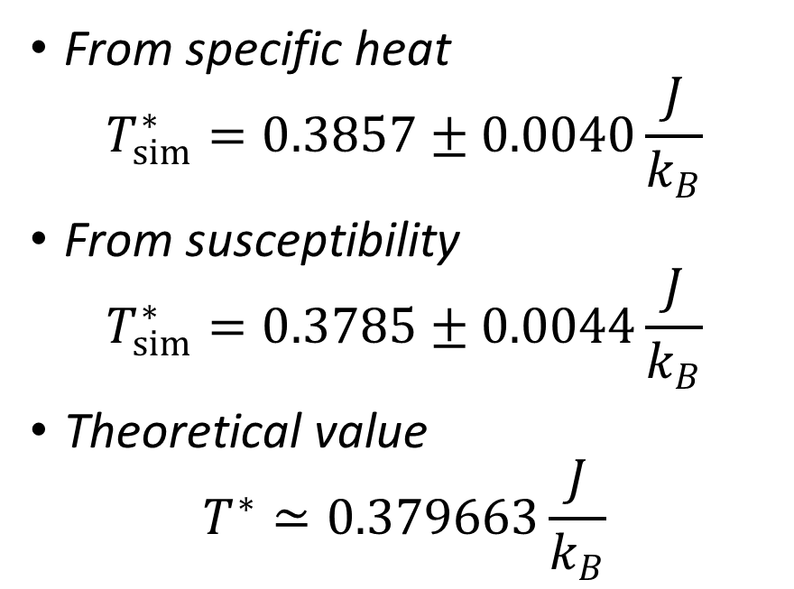
Simulation for honeycomb lattice
From specific heat
$$T_{sim}^{∗}=0.3857±0.0040\frac{J}{k_{B}}$$
From susceptibility
$$T_{sim}^{∗}=0.3785±0.0044\frac{J}{k_{B}}$$
Theoretical value
$$T^{∗}≃0.379663\frac{J}{k_{B}}$$

Slide 21
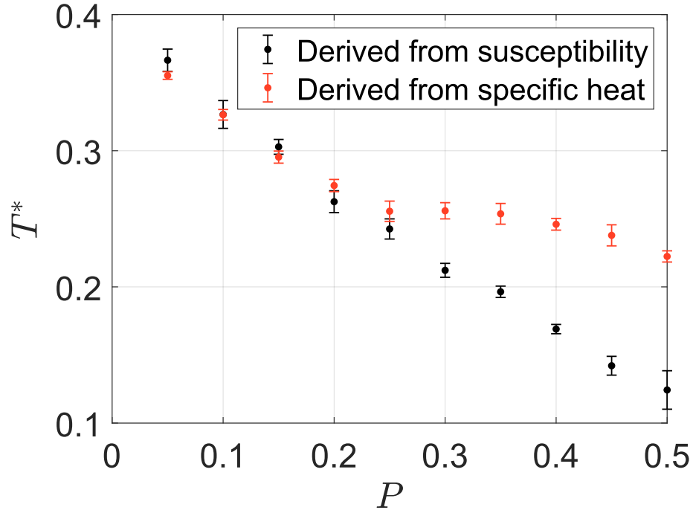
Simulation for lattice with “holes”
1J
1J
0J
0J
1J
0J
0J
0J

Slide 22
Simulation for lattice with “holes”
Interaction energies near “holes” are 0
Linearly decrease until 25%
After 30%, two critical temperature doesn’t overlap

Slide 23
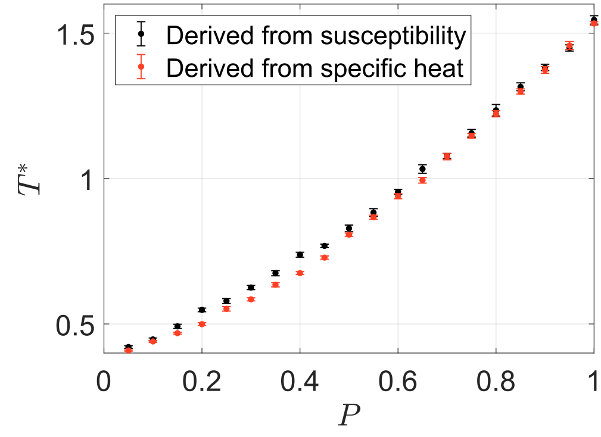
Simulation for lattice with impurity
1J
2J
4J
1J
4J
2J
2J

Slide 24
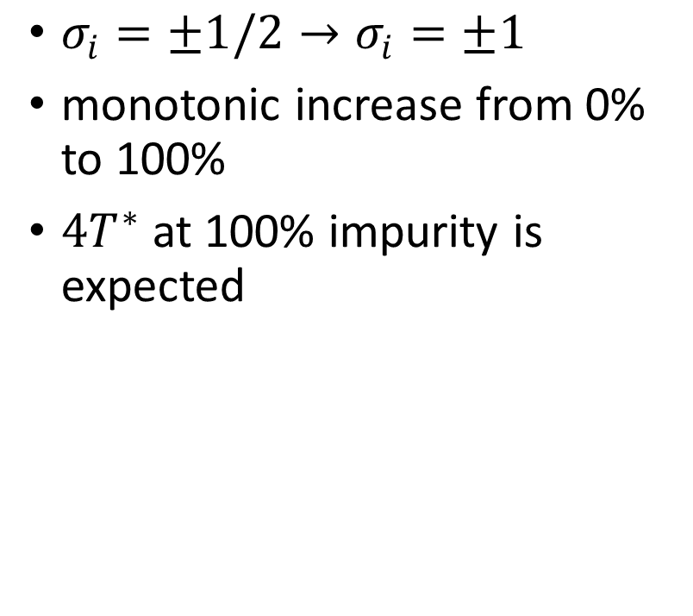
Simulation for lattice with impurity
$σ_{i}=±1/2→σ_{i}=±1$
monotonic increase from 0% to 100%
$4T^{∗}$ at 100% impurity is expected

Slide 25
Thank you

